Slide 1


Slide 2
DEEP LEARNING COURSE
FALL 2024
Usman Khan, PhD

Slide 3
BATCH NORMALIZATION
BATCH NORMALIZATION
Normalization in machine learning is a broad category of methods that seek to make different samples seen by a machine learning model more similar to each other, which helps the model learn and generalize well to new data.
The most common form of data normalization is one you’ve seen several times in this book already: centering the data on zero by subtracting the mean from the data and giving the data a unit standard deviation by dividing the data by its standard deviation.
In effect, this makes the assumption that the data follows a normal (or Gaussian) distribution and makes sure this distribution is centered and scaled to unit variance:

Slide 4
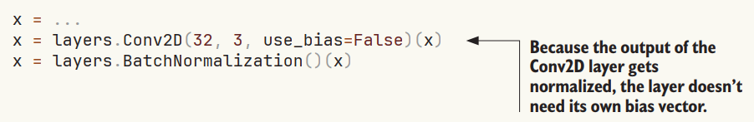
BATCH NORMALIZATION
BATCH NORMALIZATION
Data normalization may be a concern after every transformation performed by the network: even if the data entering a Dense or Conv2D network has a 0 mean and unit variance, there’s no reason to expect a priori that this will be the case for the data coming out.
Batch normalization does just that. It’s a type of layer (BatchNormalization in Keras) introduced in 2015 it can adaptively normalize data even as the mean and variance change over time during training.
During training, it uses the mean and variance of the current batch of data to normalize samples, and during inference (when a big enough batch of representative data may not be available), it uses an exponential moving average of the batchwise mean and variance of the data seen during training.
The BatchNormalization layer can be used after any layer—Dense, Conv2D, and so on:

Slide 5
BATCH NORMALIZATION
BATCH NORMALIZATION
For instance, Conv2D returns, schematically, y = conv(x, kernel) + bias, and Dense returns y = dot(x, kernel) + bias. Because the normalization step will take care of centering the layer’s output on zero, the bias vector is no longer needed when using BatchNormalization, and the layer can be created without it via the option use_bias=False. This makes the layer slightly leaner.
For instance, Conv2D returns, schematically, y = conv(x, kernel) + bias, and Dense returns y = dot(x, kernel) + bias. Because the normalization step will take care of centering the layer’s output on zero, the bias vector is no longer needed when using BatchNormalization, and the layer can be created without it via the option use_bias=False. This makes the layer slightly leaner.

Slide 6
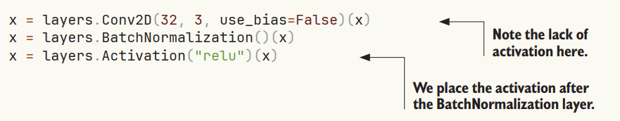
BATCH NORMALIZATION
BATCH NORMALIZATION
The intuitive reason why is that batch normalization will center your inputs on zero, while your ReLU activation uses zero as a pivot for keeping or dropping activated channels: doing normalization before the activation maximizes the utilization of the ReLU. That said, this ordering best practice is not exactly critical, so if you do convolution activation-batch normalization, your model will still train, and you won’t necessarily see worse results.

Slide 7
BATCH NORMALIZATION
BATCH NORMALIZATION
When fine-tuning a model that includes BatchNormalization layers, I recommend leaving these layers frozen (set their trainable attribute to False). Otherwise, they will keep updating their internal mean and variance, which can interfere with the very small updates applied to the surrounding Conv2D layers.

Slide 8
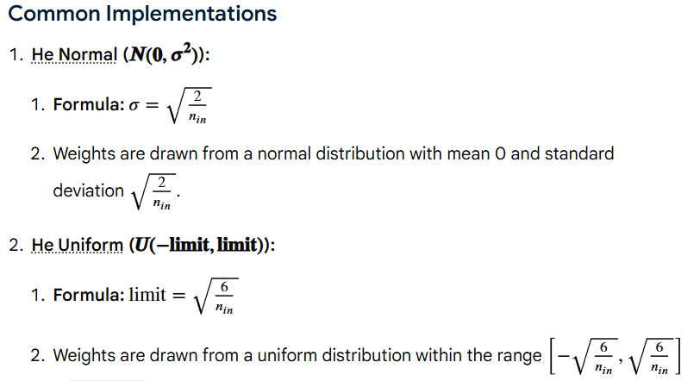
BATCH NORMALIZATION
BATCH NORMALIZATION
Although using He initialization along with ReLU or its variants can significantly reduce the danger of the vanishing/exploding gradients problems at the begin‐ ning of training, it doesn’t guarantee that they won’t come back during training.

Slide 9
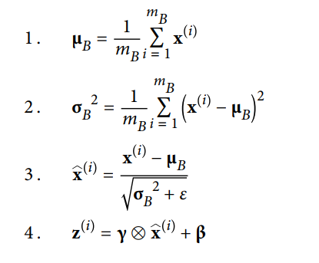
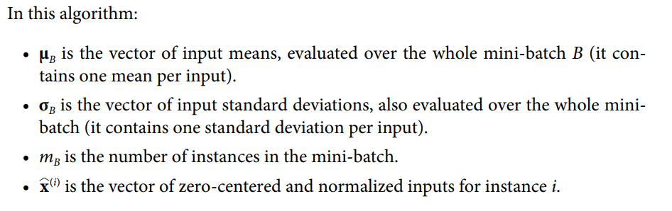
BATCH NORMALIZATION
BATCH NORMALIZATION
In order to zero-center and normalize the inputs, the algorithm needs to estimate each input’s mean and standard deviation. It does so by evaluating the mean and standard deviation of the input over the current mini-batch (hence the name “Batch Normalization”).
Algorithm

Slide 10
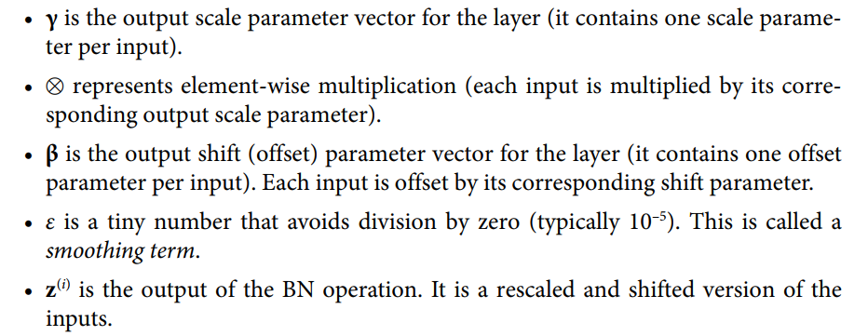
BATCH NORMALIZATION
BATCH NORMALIZATION
In order to zero-center and normalize the inputs, the algorithm needs to estimate each input’s mean and standard deviation. It does so by evaluating the mean and stan‐ dard deviation of the input over the current mini-batch (hence the name “Batch Nor‐ malization”).
Algorithm

Slide 11
BATCH NORMALIZATION
BATCH NORMALIZATION
Ioffe and Szegedy demonstrated that Batch Normalization considerably improved all the deep neural networks they experimented with, leading to a huge improvement in the ImageNet classification task (ImageNet is a large database of images classified into many classes, commonly used to evaluate computer vision systems). The vanishing gradients problem was strongly reduced, to the point that they could use saturating activation functions such as the tanh and even the logistic activation function. The networks were also much less sensitive to the weight initialization. The authors were able to use much larger learning rates, significantly speeding up the learning process
Finally, like a gift that keeps on giving, Batch Normalization acts like a regularizer, reducing the need for other regularization techniques (such as dropout )

Slide 12
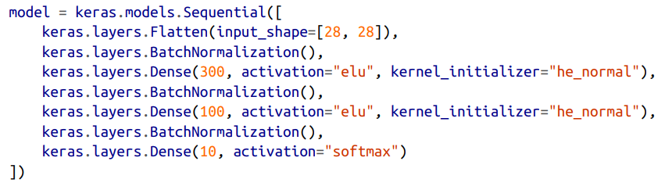
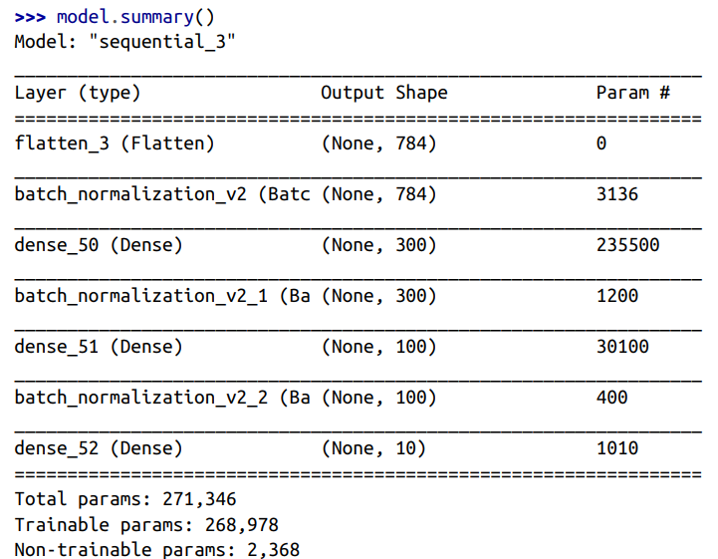
BATCH NORMALIZATION
BATCH NORMALIZATION

Slide 13
BATCH NORMALIZATION
BATCH NORMALIZATION
As you can see, each BN layer adds four parameters per input: γ, β, μ, and σ (for example, the first BN layer adds 3,136 parameters, which is 4 × 784). The last two parameters, μ and σ, are the moving averages; they are not affected by backpropaga‐ tion, so Keras calls them “non-trainable”9 (if you count the total number of BN parameters, 3,136 + 1,200 + 400, and divide by 2, you get 2,368, which is the total number of non-trainable parameters in this model)

Slide 14

GRADIENT CLIPPING
GRADIENT CLIPPING
Another popular technique to mitigate the exploding gradients problem is to clip the gradients during backpropagation so that they never exceed some threshold. This is called Gradient Clipping
This technique is most often used in recurrent neural net‐ works, as Batch Normalization is tricky to use in RNNs
In Keras, implementing Gradient Clipping is just a matter of setting the clipvalue or clipnorm argument when creating an optimizer
This optimizer will clip every component of the gradient vector to a value between –1.0 and 1.0
This means that all the partial derivatives of the loss (with regard to each and every trainable parameter) will be clipped between –1.0 and 1.0. The threshold is a hyperparameter you can tune
Note that it may change the orientation of the gradi‐ ent vector. For instance, if the original gradient vector is [0.9, 100.0], it points mostly in the direction of the second axis; but once you clip it by value, you get [0.9, 1.0], which points roughly in the diagonal between the two axes.

Slide 15
GRADIENT CLIPPING
GRADIENT CLIPPING
If you want to ensure that Gradient Clipping does not change the direc‐ tion of the gradient vector, you should clip by norm by setting clipnorm instead of clipvalue. This will clip the whole gradient if its ℓ2 norm is greater than the thres‐ hold you picked. For example, if you set clipnorm=1.0, then the vector [0.9, 100.0] will be clipped to [0.00899964, 0.9999595], preserving its orientation but almost elim‐ inating the first component.
REUSING PRETRAINED LAYERS
It is generally not a good idea to train a very large DNN from scratch: instead, you should always try to find an existing neural network that accomplishes a similar task to the one you are trying to tackle
This technique is called transfer learning. It will not only speed up training considerably, but also require significantly less training data.
Suppose you have access to a DNN that was trained to classify pictures into 100 dif‐ ferent categories, including animals, plants, vehicles, and everyday objects. You now want to train a DNN to classify specific types of vehicles.
These tasks are very similar, even partly overlapping, so you should try to reuse parts of the first network.

Slide 16
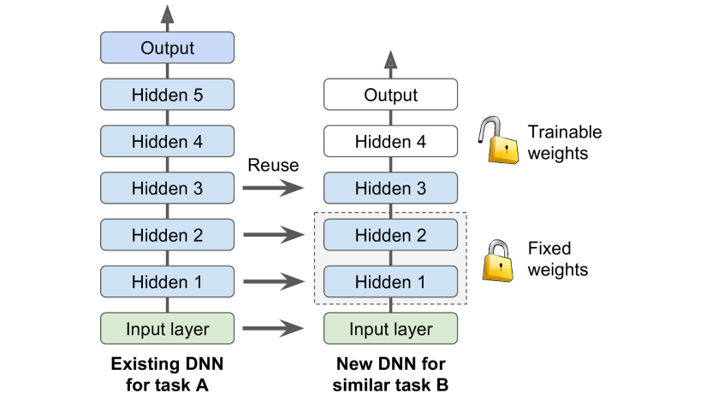
REUSING PRETRAINED LAYERS A.K.A TRANSFER LEARNING
REUSING PRETRAINED LAYERS
The output layer of the original model should usually be replaced because it is most likely not useful at all for the new task, and it may not even have the right number of outputs for the new task.
Similarly, the upper hidden layers of the original model are less likely to be as useful as the lower layers, since the high-level features that are most useful for the new task may differ significantly from the ones that were most useful for the original task.
Try freezing all the reused layers first (i.e., make their weights non-trainable so that Gradient Descent won’t modify them), then train your model and see how it per‐ forms. Then try unfreezing one or two of the top hidden layers to let backpropaga‐ tion tweak them and see if performance improves.

Slide 17

REUSING PRETRAINED LAYERS A.K.A TRANSFER LEARNING
REUSING PRETRAINED LAYERS
Suppose you have trained a medical image dataset to diagnose three types of diseases. Now you want to diagnose Brain Tumor in Medical CT Scans
You have limited number of image dataset available. So you plan to use the same pretrained model.
You decide to reuse the same model and replace the last layer with your own Fully Connected Layer & since you have to only two outcomes,i-e Brain Tumor is positive or negative so you will use sigmoid Activation
Note that model_A and model_B_on_A now share some layers. When you train model_B_on_A, it will also affect model_A. If you want to avoid that, you need to clone model_A before you reuse its layers. To do this, you clone model A’s architecture with clone_model(), then copy its weights

Slide 18

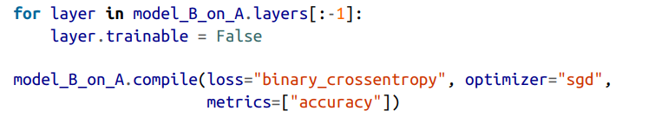
REUSING PRETRAINED LAYERS A.K.A TRANSFER LEARNING
REUSING PRETRAINED LAYERS
So, once you clone the model you also copy the weights of the model as follows:-
Now you could train model_B_on_A for task B, but since the new output layer was ini‐ tialized randomly it will make large errors (at least during the first few epochs), so there will be large error gradients that may wreck the reused weights. To avoid this, one approach is to freeze the reused layers during the first few epochs, giving the new layer some time to learn reasonable weights.
To do this, set every layer’s trainable attribute to False and compile the model:

Slide 19
REUSING PRETRAINED LAYERS A.K.A TRANSFER LEARNING
REUSING PRETRAINED LAYERS
So, once you clone the model you also copy the weights of the model as follows:-
Now you could train model_B_on_A for task B, but since the new output layer was ini‐ tialized randomly it will make large errors (at least during the first few epochs), so there will be large error gradients that may wreck the reused weights. To avoid this, one approach is to freeze the reused layers during the first few epochs, giving the new layer some time to learn reasonable weights.
To do this, set every layer’s trainable attribute to False and compile the model:

Slide 20
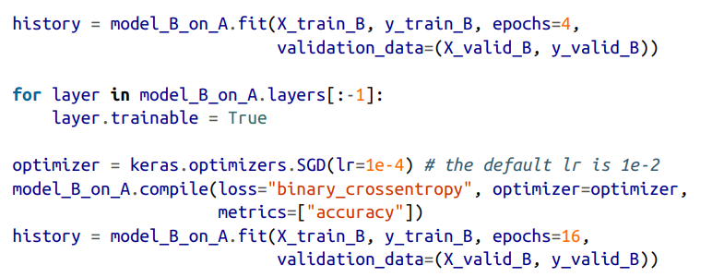

REUSING PRETRAINED LAYERS A.K.A TRANSFER LEARNING
REUSING PRETRAINED LAYERS
Now you can train the model for a few epochs, then unfreeze the reused layers (which requires compiling the model again) and continue training to fine-tune the reused layers for task B. After unfreezing the reused layers, it is usually a good idea to reduce the learning rate, once again to avoid damaging the reused weights:

Slide 21

RECURRENT NEURAL NETWORKS
RNN CELL
Traditional multilayer perceptron neural networks make the assumption that all inputs are independent of each other. This assumption is not true for many types of sequence data. For example, words in a sentence, musical notes in a composition, stock prices over time, or even molecules in a compound are examples of sequences where an element will display a dependence on previous elements.
RNN cells incorporate this dependence by having a hidden state, or memory, that holds the essence of what has been seen so far. The value of the hidden state at any point in time is a function of the value of the hidden state at the previous time step, and the value of the input at the current time step
H_t and h_t-1 are the values of the hidden states at the time t and t-1 respectively, and x_t is the value of the input at time t. Notice that the equation is recursive, that is, h_t-1 can be represented in terms of h_t-2 and x_t-1, and so on, until the beginning of the sequence. This is how RNNs encode and incorporate information from arbitrarily long sequences.

Slide 22
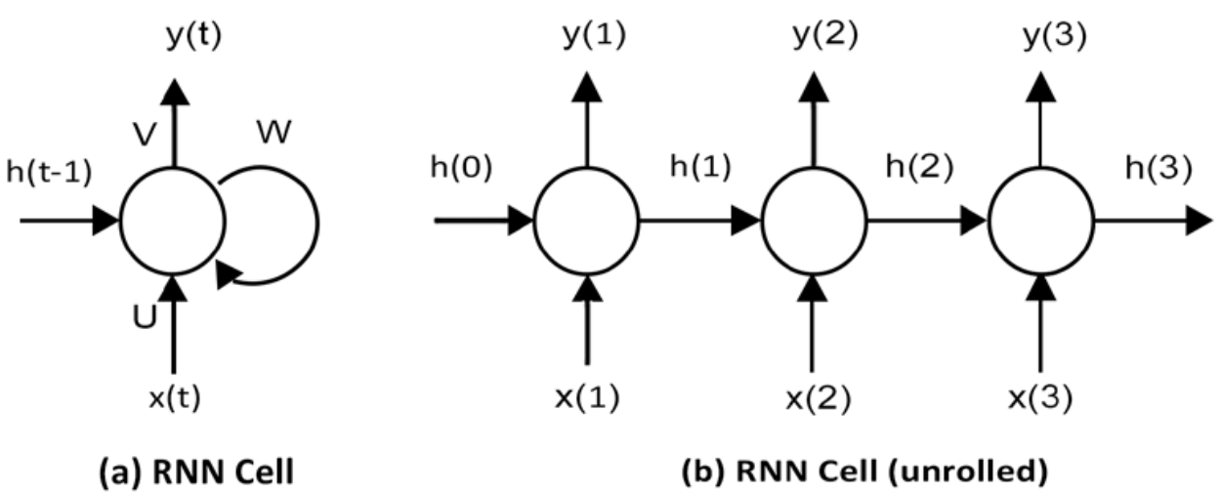
RECURRENT NEURAL NETWORKS
RNN CELL
We can also represent the RNN cell graphically, as shown in Figure. At time t, the cell has an input x(t) and output y(t). Part of the output y(t) (represented by the hidden state ht) is fed back into the cell for use at a later time step t+1.
Just as in a traditional neural network, where the learned parameters are stored as weight matrices, the RNN’s parameters are defined by the three weight matrices U, V, and W, corresponding to the weights of the input, output, and hidden states respectively

Slide 23
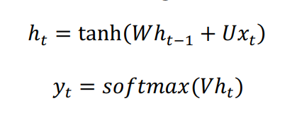
RECURRENT NEURAL NETWORKS
RNN CELL
As in the figure At time t, the cell has an input x(t) and output y(t). Part of the output y(t) (represented by the hidden state h_t) is fed back into the cell for use at a later time step t+1.
Just as in a traditional neural network, where the learned parameters are stored as weight matrices, the RNN’s parameters are defined by the three weight matrices U, V, and W, corresponding to the weights of the input, output, and hidden states respectively
The internal state of the RNN at a time t is given by the value of the hidden vector h(t), which is the sum of the weight matrix W and the hidden state h_t-1 at time t-1, and the product of the weight matrix U and the input x_t at time t, passed through a tanh activation function.
The output vector y_t at time t is the product of the weight matrix V and the hidden state h_t, passed through a softmax activation, such that the resulting vector is a set of output probabilities:

Slide 24
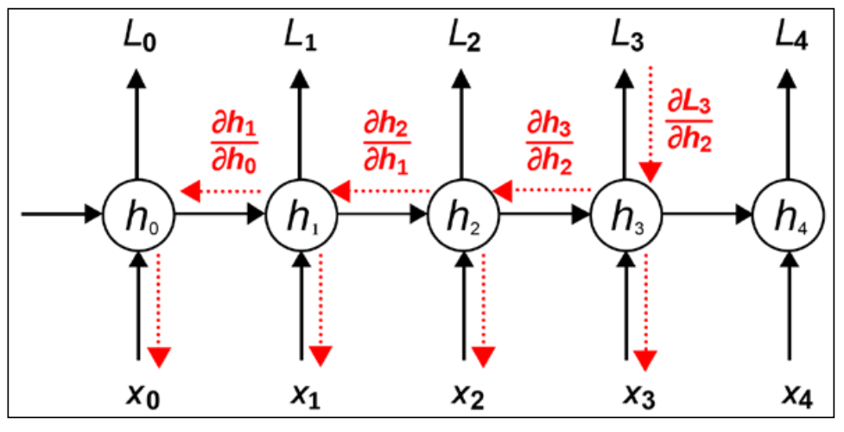
RECURRENT NEURAL NETWORKS
Back Propagation Through Time
Just like traditional neural networks, training RNNs also involves the backpropagation of gradients. The difference, in this case, is that since the weights are shared by all time steps, the gradient at each output depends not only on the current time step but also on the previous ones
This process is called backpropagation through time. Because the weights U, V, and W, are shared across the different time steps in the case of RNNs, we need to sum up the gradients across the various time steps in the case of BPTT. This is the key difference between traditional backpropagation and BPTT.
Consider the RNN with five time steps shown in Figure. During the forward pass, the network produces predictions ŷ_t at time t that are compared with the label y_t to compute a loss L_t. During backpropagation (shown by the dotted lines), the gradients of the loss with respect to the weights U, V, and W, are computed at each time step and the parameters updated with the sum of the gradients

Slide 25
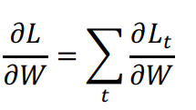
RECURRENT NEURAL NETWORKS
Back Propagation Through Time
The following equation shows the gradient of the loss with respect to W. We focus on this weight because it is the cause of the phenomenon known as the vanishing and exploding gradient problem. This problem manifests as the gradients of the loss approaching either zero or infinity, making the network hard to train. To understand why this happens, consider the equation of the Simple RNN we saw earlier; the hidden state h_t is dependent on h_t-1, which in turn is dependent on h_t-2, and so on

Slide 26
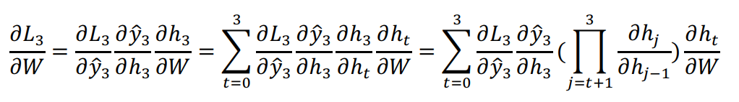
RECURRENT NEURAL NETWORKS
Back Propagation Through Time
Let’s now see what happens to this gradient at time step t=3. By the chain rule, the gradient of the loss with respect to W can be decomposed to a product of three sub-gradients. The gradient of the hidden state h2 with respect to W can be further decomposed as the sum of the gradient of each hidden state with respect to the previous one.
Finally, each gradient of the hidden state with respect to the previous one can be further decomposed as the product of gradients of the current hidden state against the previous hidden state:

Slide 27
RECURRENT NEURAL NETWORKS
Back Propagation Through Time
The reason BPTT is particularly sensitive to the problem of vanishing and exploding gradients comes from the product part of the expression representing the final formulation of the gradient of the loss with respect to W. Consider the case where the individual gradients of a hidden state with respect to the previous one are less than 1.
As we backpropagate across multiple time steps, the product of gradients becomes smaller and smaller, ultimately leading to the problem of vanishing gradients. Similarly, if the gradients are larger than 1, the products get larger and larger, and ultimately lead to the problem of exploding gradients.
TensorFlow 2.0 allows you to clip gradients using the clipvalue or clipnorm parameter during optimizer construction, or by explicitly clipping gradients using tf.clip_by_value.
The effect of vanishing gradients is that gradients from time steps that are far away do not contribute anything to the learning process, so the RNN ends up not learning any long-range dependencies. While there are a few approaches toward minimizing the problem, such as proper initialization of the W matrix, more aggressive regularization, using ReLU instead of tanh activation, and pretraining the layers using unsupervised methods, the most popular solution is to use LSTM or GRU architectures.

Slide 28
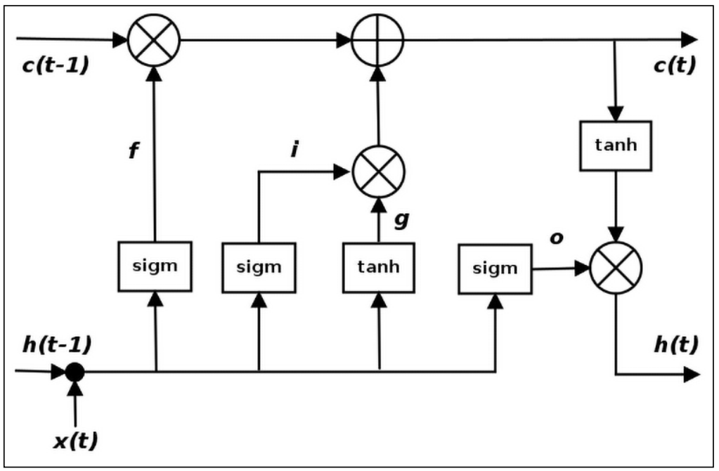
RECURRENT NEURAL NETWORKS
Back Propagation Through Time
The LSTM is a variant of the Simple RNN cell that is capable of learning long-term dependencies. LSTMs were first proposed by Hochreiter and SchmidHuber and refined by many other researchers. They work well on a large variety of problems and are the most widely used RNN variant.
We have seen how the Simple RNN combines the hidden state from the previous time step and the current input through a tanh layer to implement recurrence. LSTMs also implement recurrence in a similar way, but instead of a single tanh layer, there are four layers interacting in a very specific way. Figure illustrates the transformations that are applied in the hidden state at time step t.

Slide 29
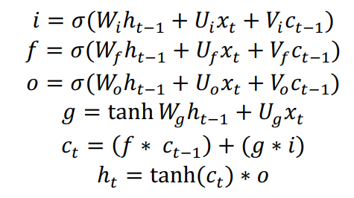
RECURRENT NEURAL NETWORKS
Back Propagation Through Time
The set of equations representing an LSTM is shown as follows
Here, i, f, and o are the input, forget, and output gates. They are computed using the same equations but with different parameter matrices W_i, U_i, W_f, U_f, and W_o, U_o. The sigmoid function modulates the output of these gates between 0 and 1, so the output vectors produced can be multiplied element-wise with another vector to define how much of the second vector can pass through the first one.

Slide 30
RECURRENT NEURAL NETWORKS
Back Propagation Through Time
The forget gate defines how much of the previous state h_t-1 you want to allow to pass through. The input gate defines how much of the newly computed state for the current input x_t you want to let through, and the output gate defines how much of the internal state you want to expose to the next layer. The internal hidden state g is computed based on the current input x_t and the previous hidden state h_t-1. Notice that the equation for g is identical to that of the Simple RNN, except that in this case, we will modulate the output by the output of input vector i.
Given i, f, o, and g, we can now calculate the cell state c_t at time t as the cell state c_t-1 at time (t-1) multiplied by the value of the forget gate g, plus the state g multiplied by the input gate i.

Slide 31
RECURRENT NEURAL NETWORKS
Back Propagation Through Time
This is basically a way to combine the previous memory and the new input – setting the forget gate to 0 ignores the old memory and setting the input gate to 0 ignores the newly computed state. Finally, the hidden state h_t at time t is computed as the memory c_t at time t, with the output gate o.
One thing to realize is that the LSTM is a drop-in replacement for a Simple RNN cell; the only difference is that LSTMs are resistant to the vanishing gradient problem. You can replace an RNN cell in a network with an LSTM without worrying about any side effects. You should generally see better results along with longer training times

Slide 32
RECURRENT NEURAL NETWORKS
LSTM Example
Air line Passenger Prediction Problem
import pandas
import matplotlib.pyplot as plt
import tensorflow as tf
import numpy as np
from tensorflow.keras.models import Sequential
from tensorflow.keras.layers import Dense
from tensorflow.keras.layers import LSTM
from sklearn.preprocessing import MinMaxScaler
from sklearn.metrics import mean_squared_error
# fix random seed for reproducibility
tf.random.set_seed(7)
path = "Lecture_8/airline_passengers.txt"
df = pandas.read_csv(path, usecols=[1], engine="python")
# Save as .csv
df.to_csv('Lecture_8/airline_passengers.csv', index=False)
# View the data
#plt.plot(dataset)
#plt.show()
dataset = df.values
dataset = dataset.astype('float32')

Slide 33
RECURRENT NEURAL NETWORKS
scaler = MinMaxScaler(feature_range=(0, 1))
dataset = scaler.fit_transform(dataset)
'''
After you model the data and estimate the skill of your model on the training dataset,
you need to get an idea of the skill of the model on new unseen data.
For a normal classification or regression problem, you would do this using cross validation.
With time series data, the sequence of values is important.
A simple method that you can use is to split the ordered dataset into train and test datasets.
The code below calculates the index of the split point and separates the data into the training datasets,
with 67% of the observations used to train the model, leaving the remaining 33% for testing the model.
'''
def create_dataset(dataset, look_back=1):
dataX, dataY = [], []
for i in range(len(dataset)-look_back-1):
a = dataset[i:(i+look_back), 0]
dataX.append(a)
dataY.append(dataset[i + look_back, 0])
return np.array(dataX), np.array(dataY)

Slide 34
train_size = int(len(dataset) * 0.67)
test_size = len(dataset) - train_size
train, test = dataset[0:train_size,:], dataset[train_size:len(dataset),:]
print(len(train), len(test))
'''
The function takes two arguments: the dataset, which is a NumPy array you want to convert into a dataset,
and the look_back, which is the number of previous time steps to use as input variables to predict the next time
period—in this case, defaulted to 1. This default will create a dataset where X is the number of passengers
at a given time (t), and Y is the number of passengers at the next time (t + 1).
'''
RECURRENT NEURAL NETWORKS
look_back = 1
trainX, trainY = create_dataset(train, look_back)
testX, testY = create_dataset(test, look_back)
'''
The LSTM network expects the input data (X) to be provided with a specific array structure in the form of
[samples, time steps, features].
'''
trainX = np.reshape(trainX, (trainX.shape[0], 1, trainX.shape[1]))
testX = np.reshape(testX, (testX.shape[0],1, testX.shape[1]))
# create and fit the LSTM network

Slide 35
RECURRENT NEURAL NETWORKS
input_layer = tf.keras.layers.Input(shape=(1, look_back))
Lstm_layer = tf.keras.layers.LSTM(4)(input_layer)
output_layer = tf.keras.layers.Dense(1)(Lstm_layer)
model = tf.keras.Model(inputs=input_layer, outputs=output_layer)
model.compile(loss='mean_squared_error', optimizer='adam')
model.fit(trainX, trainY, epochs=100, batch_size=1, verbose=2)
# make predictions
trainPredict = model.predict(trainX)
testPredict = model.predict(testX)
# invert Predictions
trainPredict = scaler.inverse_transform(trainPredict)
trainY = scaler.inverse_transform([trainY])
testPredict = scaler.inverse_transform(testPredict)
testY = scaler.inverse_transform([testY])
# calculate root mean squared error
trainScore = np.sqrt(mean_squared_error(trainY[0], trainPredict[:,0]))
print('Train Score: %.2f RMSE' % (trainScore))
testScore = np.sqrt(mean_squared_error(testY[0], testPredict[:,0]))
print('Test Score: %.2f RMSE' % (testScore))
# shift train predictions for plotting
trainPredictPlot = np.empty_like(dataset)
trainPredictPlot[:, :] = np.nan
trainPredictPlot[look_back:len(trainPredict)+look_back, :] = trainPredict
# shift test predictions for plotting
testPredictPlot = np.empty_like(dataset)
testPredictPlot[:, :] = np.nan
testPredictPlot[len(trainPredict)+(look_back*2)+1:len(dataset)-1, :] = testPredict
# plot baseline and predictions
plt.plot(scaler.inverse_transform(dataset))
plt.plot(trainPredictPlot)
plt.plot(testPredictPlot)
plt.show()

Slide 36
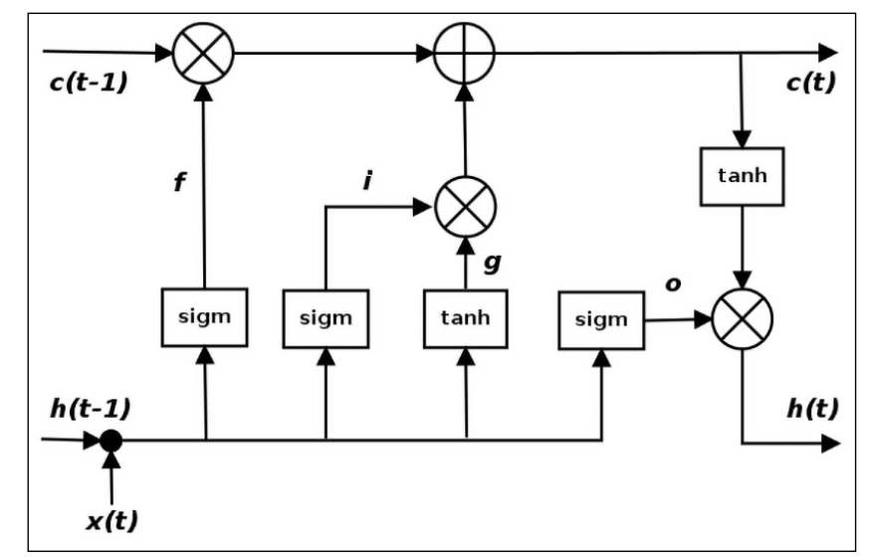
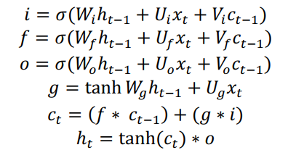
LSTMS SET OF EQUATIONS
Here, i, f, and o are the input, forget, and output gates. They are computed using the same equations but with different parameter matrices Wi, Ui, Wf, Uf, and Wo, Uo.
The sigmoid function modulates the output of these gates between 0 and 1, so the output vectors produced can be multiplied element-wise with another vector to define how much of the second vector can pass through the first one.

Slide 37
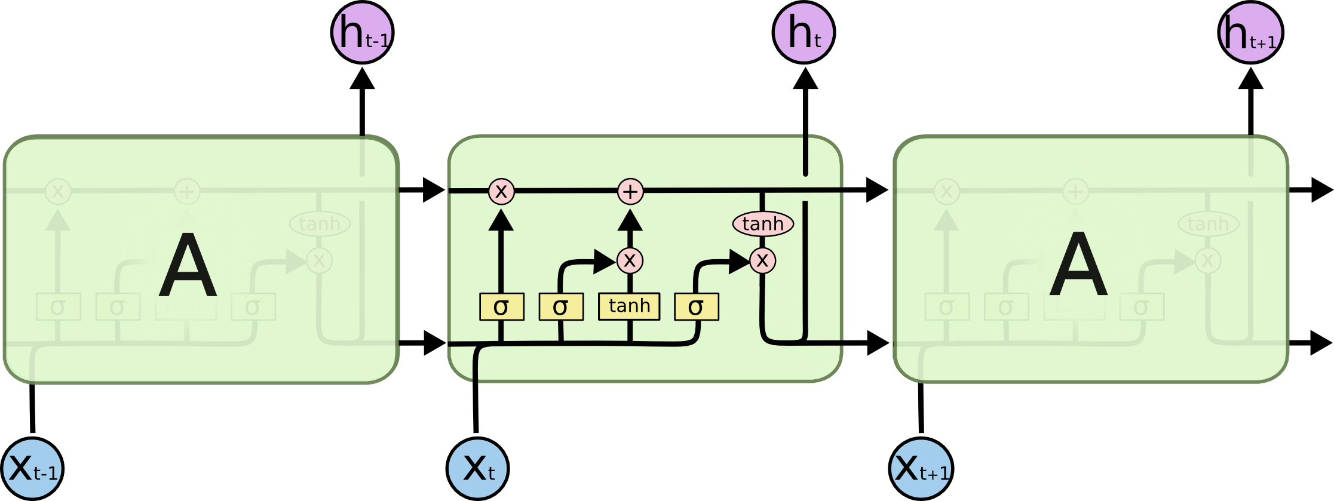
LSTM NETWORK

Slide 38
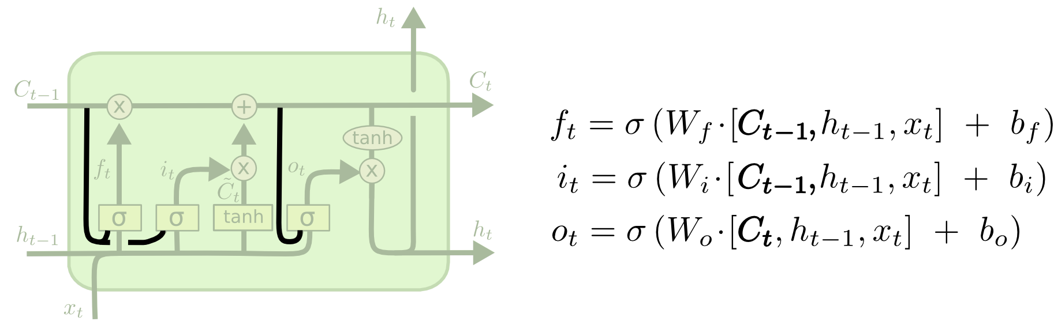
PEEP HOLE LSTM
It adds “peepholes” to the input, forget, and output gates, so they can see the previous cell state ct-1
Decisions will be made taking into account the long term memory

Slide 39
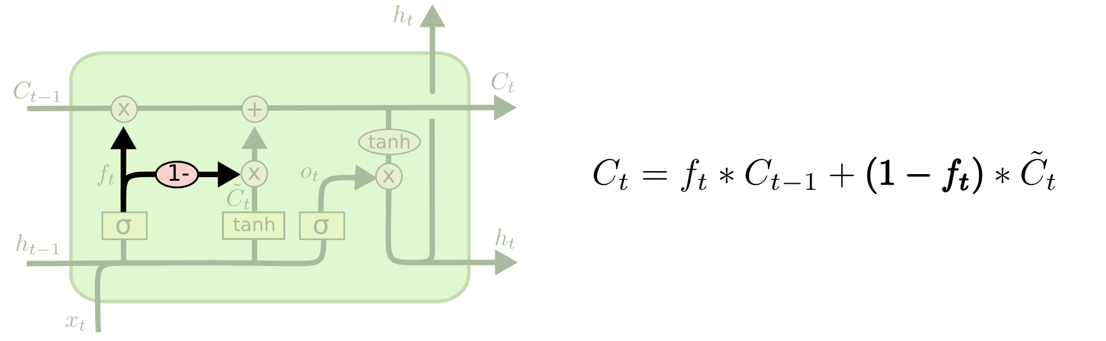
COUPLED FORGET & INPUT GATE LSTM
Instead of having a separate decision what to store in the long term memory based on input and short term memory only
Now we have an input from the long term memory as well

Slide 40
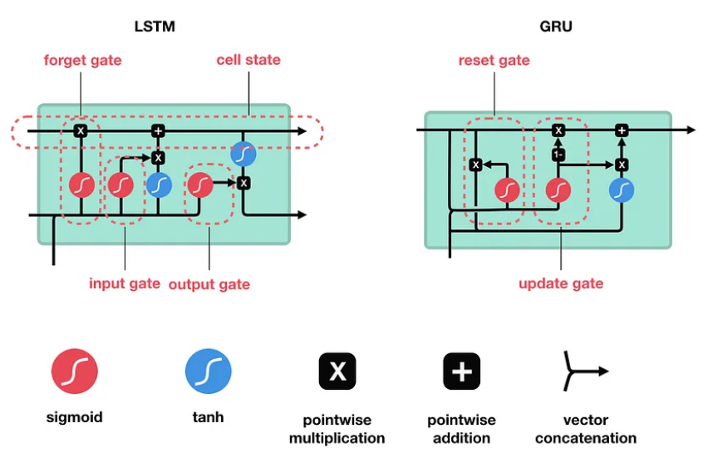
GATED RECURRENT UNIT (GRU)

Slide 41
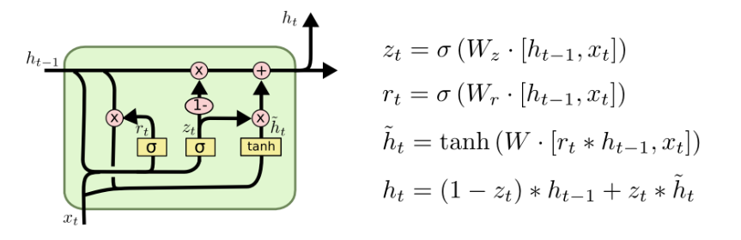
GATED RECURRENT UNIT (GRU)
A slightly more dramatic variation on the LSTM is the Gated Recurrent Unit, or GRU, introduced by Cho, et al. (2014).
It combines the forget and input gates into a single “update gate.” The resulting model is simpler than standard LSTM models, and has been growing increasingly popular.

Slide 42
GATED RECURRENT UNIT (GRU)
The GRU is a variant of the LSTM
It retains the LSTM’s resistance to the vanishing gradient problem, but its internal structure is simpler
Faster to train, since fewer computations are needed to make updates to its hidden state
Instead of the input (i), forgot (f), and output (o) gates in the LSTM cell, the GRU cell has two gates,
An update gate z and a reset gate r
The update gate defines how much previous memory to keep around
The reset gate defines how to combine the new input with the previous memory
There is no persistent cell state distinct from the hidden state as it is in LSTM

Slide 43
COMPARISON OF GRUS & LSTMS
Ser | LSTMs | GRUs
a. | LSTM has a more complex architecture compared to GRU. It consists of three gates: the input gate (i), forget gate (f), and output gate (o). These gates control the flow of information through the cell state, allowing the LSTM to remember or forget information over time. | GRU has a simplified architecture with two gates: the update gate (z) and reset gate (r). The update gate controls how much of the previous hidden state should be retained, and the reset gate determines how much of the past information to forget.
b. | LSTM typically has more parameters than GRU due to the additional gate (forget gate). This can make LSTM more powerful but also more prone to overfitting, especially on smaller datasets. | GRU has fewer parameters since it lacks the forget gate. This can make it more computationally efficient and less prone to overfitting, making it a good choice for smaller datasets.
c. | Due to its more complex architecture, LSTM can potentially learn more complex patterns and relationships in the data. It is well-suited for tasks where capturing long-term dependencies is critical. | While simpler, GRU can still learn to capture long-term dependencies effectively. It performs well in many natural language processing tasks and is a popular choice for various sequence modeling tasks.
d. | LSTM has more parameters, which can result in slightly slower training times compared to GRU, especially on larger datasets. | With fewer parameters, GRU may have faster training times, making it more efficient for larger datasets.

